Slide 1


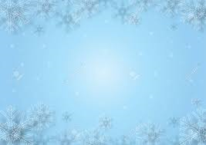
Holiday Decoration Safety:
  Electric string lights and wiring must be Underwriters Laboratories (or equivalent) approved.
  Do Not link more than 3 strands of holiday lights.
  Always unplug electrical decorations before replacing bulbs or fuses.
  Turn OFF decorations before leaving the office, your home, or going to sleep.
  Inspect all electrical decorations for damage before use.
    - Damaged cords may cause a serious shock or can start a fire.
    - Ensure they don’t have any frayed or pinched wires.
- Discard any worn decorations.
  Decorations shall be noncombustible or fire retardant.
  - Use of an open flame is PROHIBITED.
  Decorations shall NOT obstruct exits (access to, egress from, or visibility of). In other words don’t hang things across your doors.

Slide 2
Holiday Decoration Safety(continued)
  Use lights where they are supposed to be used. (Indoor lights used indoors & outdoor lights used outdoors.)
  Protect electrical cords from damage.
- Cords should never be pinched by furniture, forced into small spaces, placed under rugs, located near heat sources or attached by nails, tacks, or staples.
- Use insulated clip hangers.
  Do not place extension cords where they could cause a tripping hazard, like doorways.
  Never string extension cords together (NO daisy chains!!!)
  Avoid overloading outlets and only plug one high-wattage appliance into each outlet.
  NEVER block fire exits
  Do not hang decorations on sprinklers/alarms or block them with anything!
  If you use a ladder…Heed the warnings on the ladder.

